Slide 1
PLANNING COMMISSION
Board of Supervisors Chambers
400 County Center, Redwood City
ITEM # 2
Applicant: San Mateo County Parks
Owner: County of San Mateo
File Number: PLN 2021-00485
Location: Tunitas Creek Beach, Unincorporated San Gregorio
APN: 081-060-020, -030, and -130
Project Description: Consideration of a pedestrian Lighting Plan, per Condition of Approval No. 25 of the October 26, 2022 Planning Commission Approval for the Tunitas Creek County Park.
PLANNING AND BUILDING DEPARTMENT
Notes:
1

Slide 2
PRESENTATION OUTLINE
Project Location
Project Description
Staff’s Recommendation
PLANNING AND BUILDING DEPARTMENT
Notes:
2

Slide 3
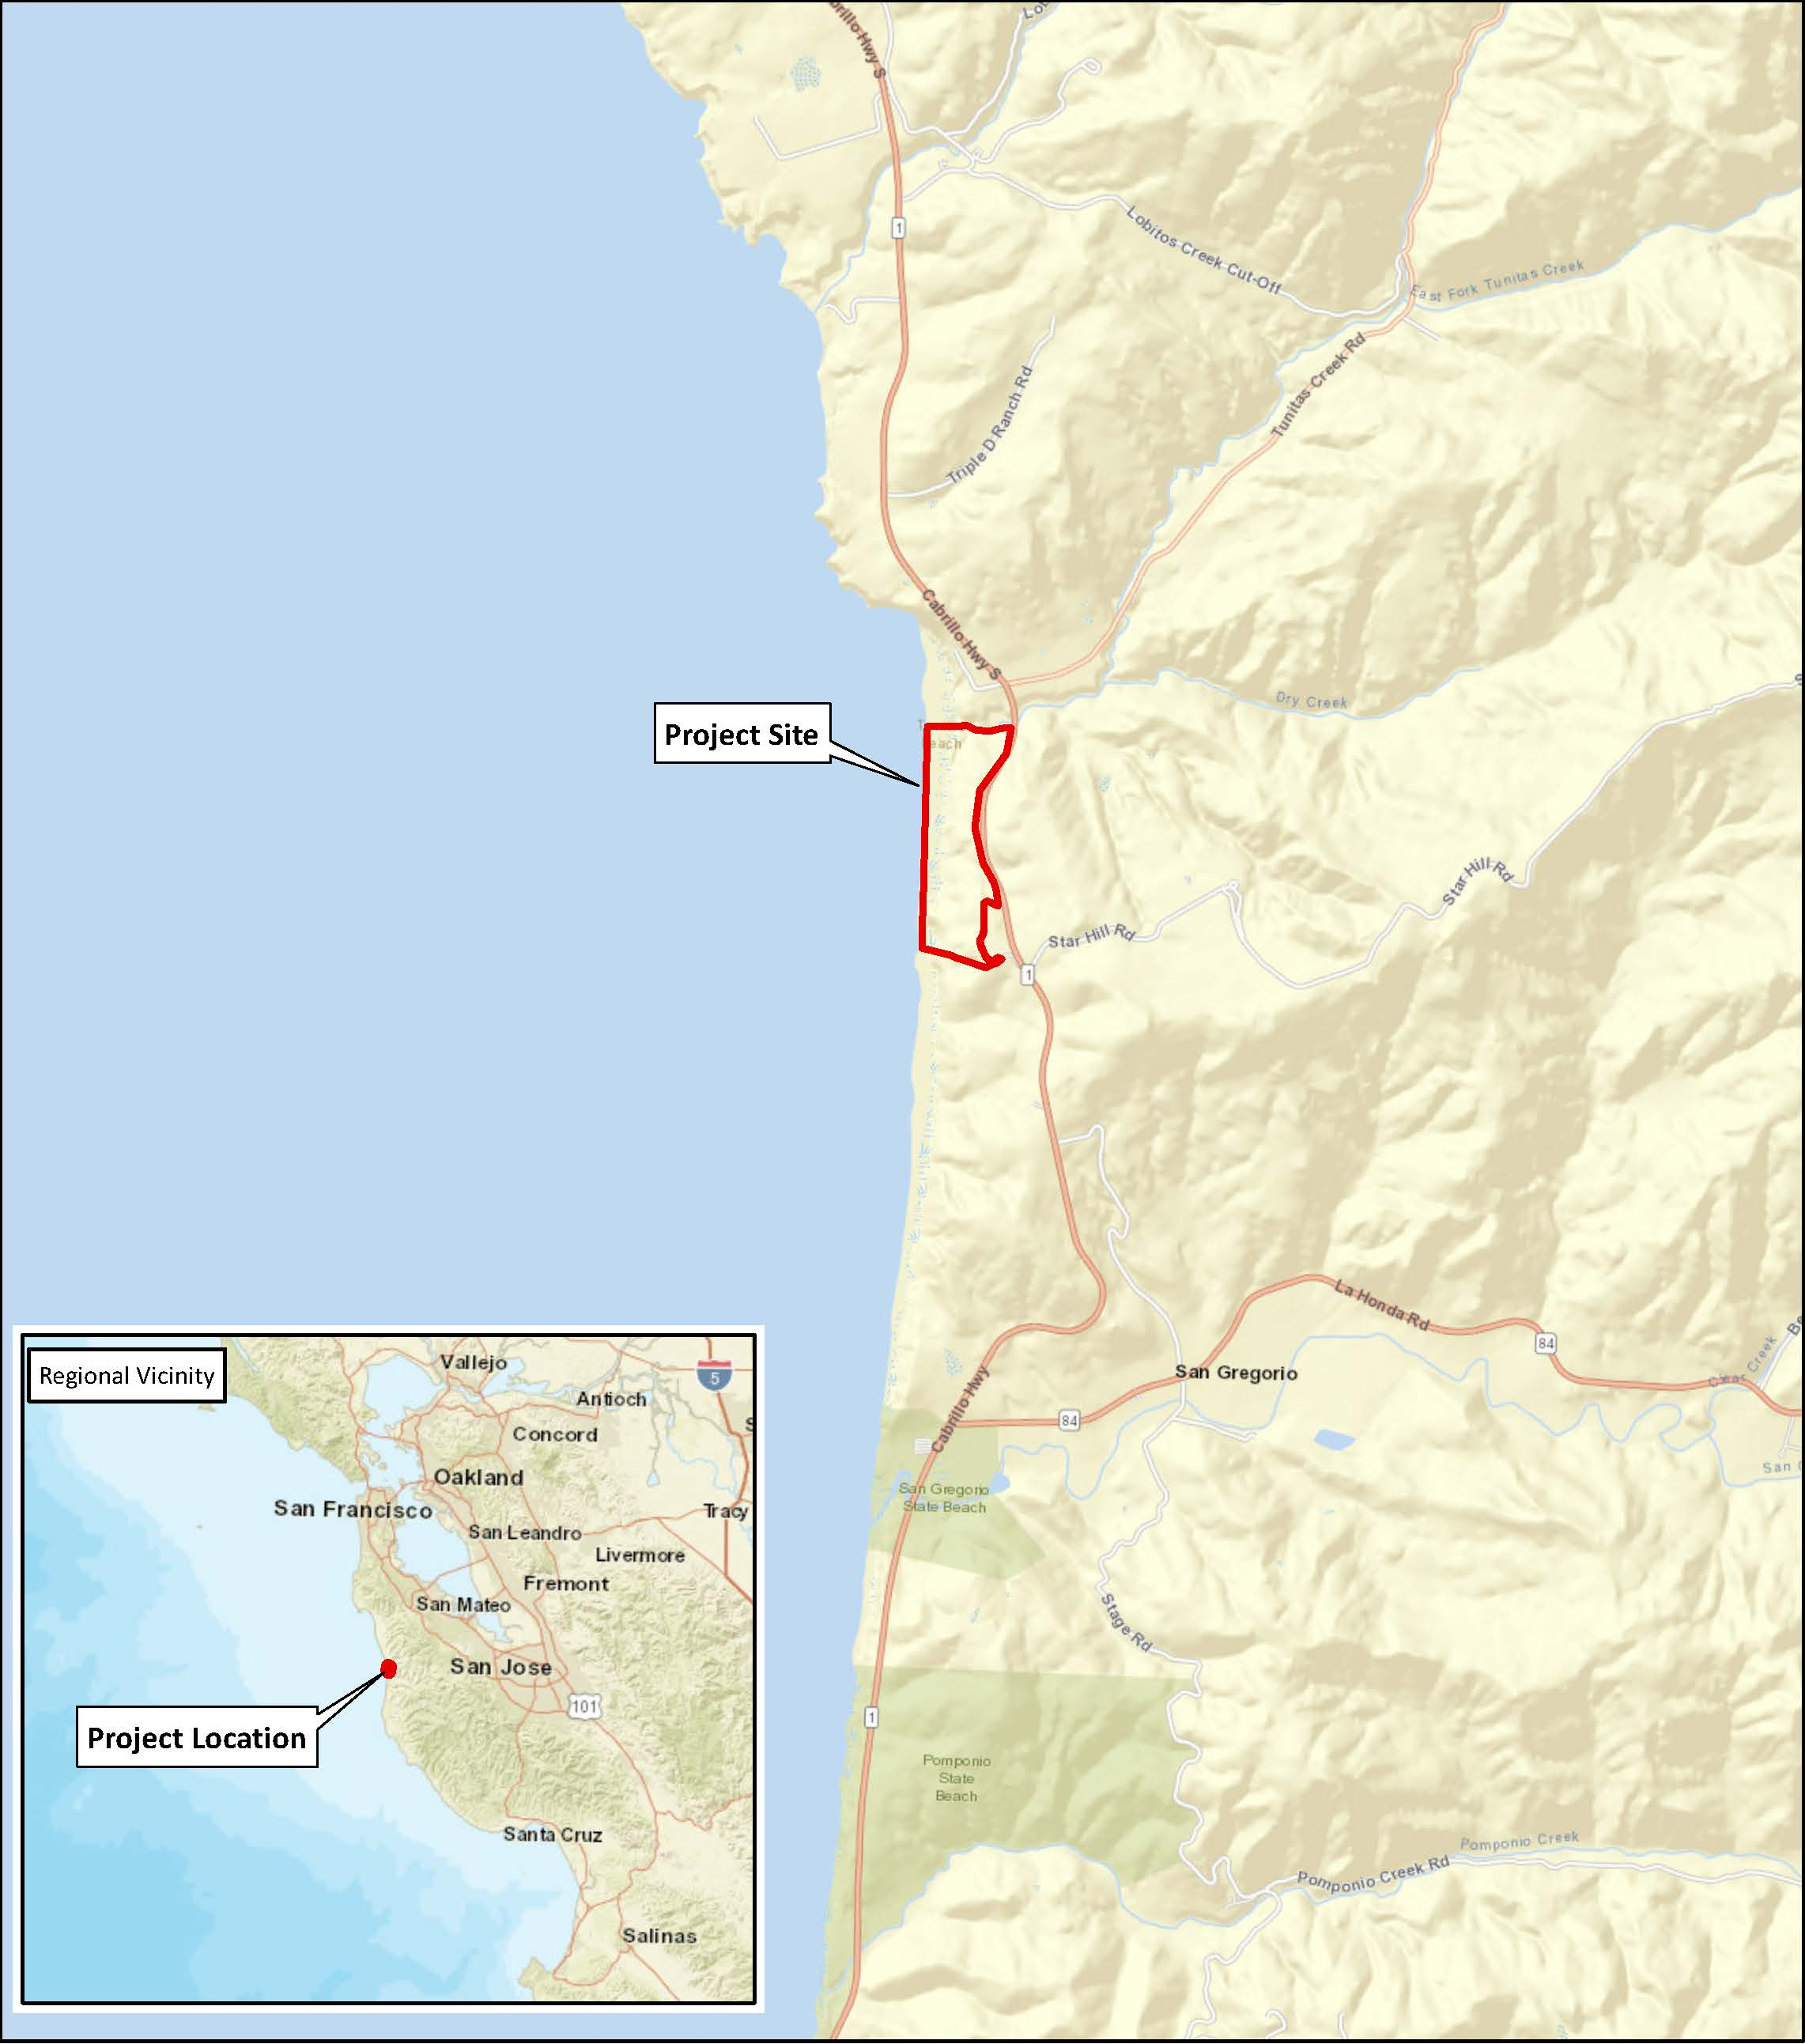

Slide 4
PRESENTATION OUTLINE
Project Location
Project Description
LCP Compliance
PLANNING AND BUILDING DEPARTMENT
Notes:
4

Slide 5
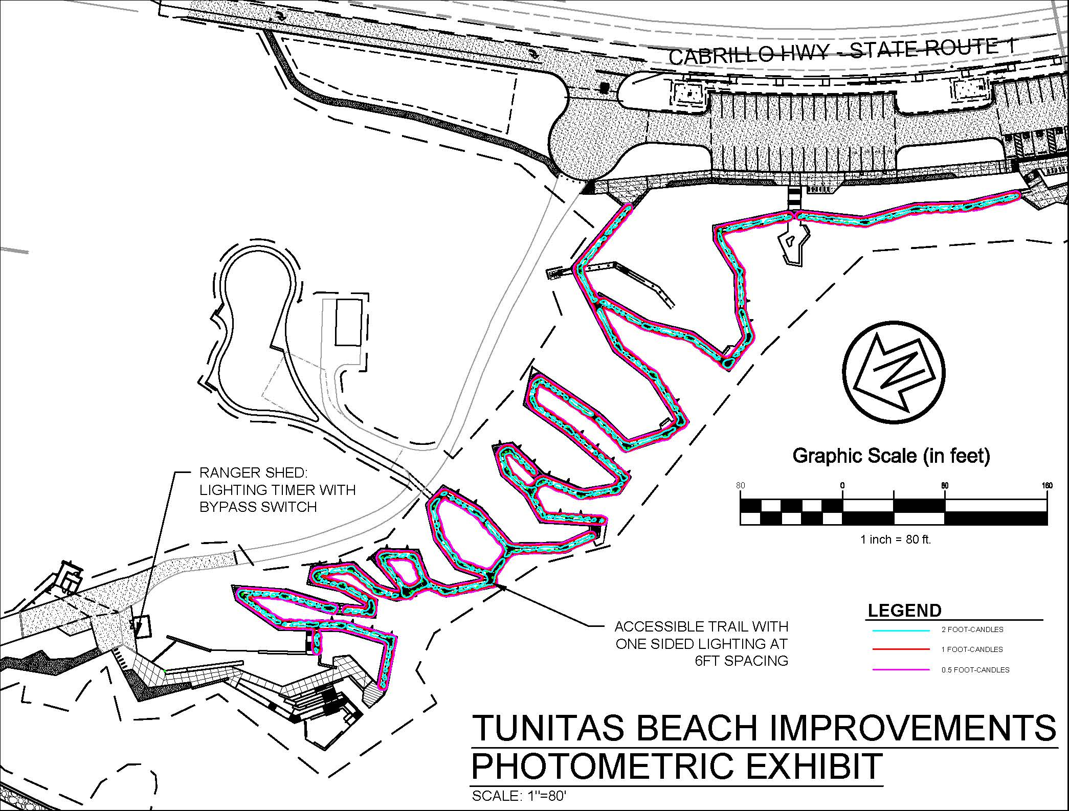

Slide 6
PRESENTATION OUTLINE
Project Location
Project Description
LCP Compliance
PLANNING AND BUILDING DEPARTMENT
Notes:
6

Slide 7
LCP COMPLIANCE
Policy 8.18 (Development Design) –
Development to be as unobtrusive as possible – LED lighting fixtures on underside of handrailing.
Exterior lighting limited to minimum necessary for safety – handrail at waist height, so intensity of light can be kept low and transmit at the yellow end of the color spectrum.
Lighting shielded to confine direct rays to project parcel - Lights focused downward only illuminating small area at each light location.
PLANNING AND BUILDING DEPARTMENT
Notes:
7

Slide 9
LCP COMPLIANCE
Policy 8.18 (Development Design) –
Development to be as unobtrusive as possible – LED lighting fixtures on underside of handrailing.
Exterior lighting limited to minimum necessary for safety – handrail at waist height, so intensity of light can be kept low and transmit at the yellow end of the color spectrum.
Lighting shielded to confine direct rays to project parcel - Lights focused downward only illuminating small area at each light location.
PLANNING AND BUILDING DEPARTMENT
Notes:
9

Slide 10
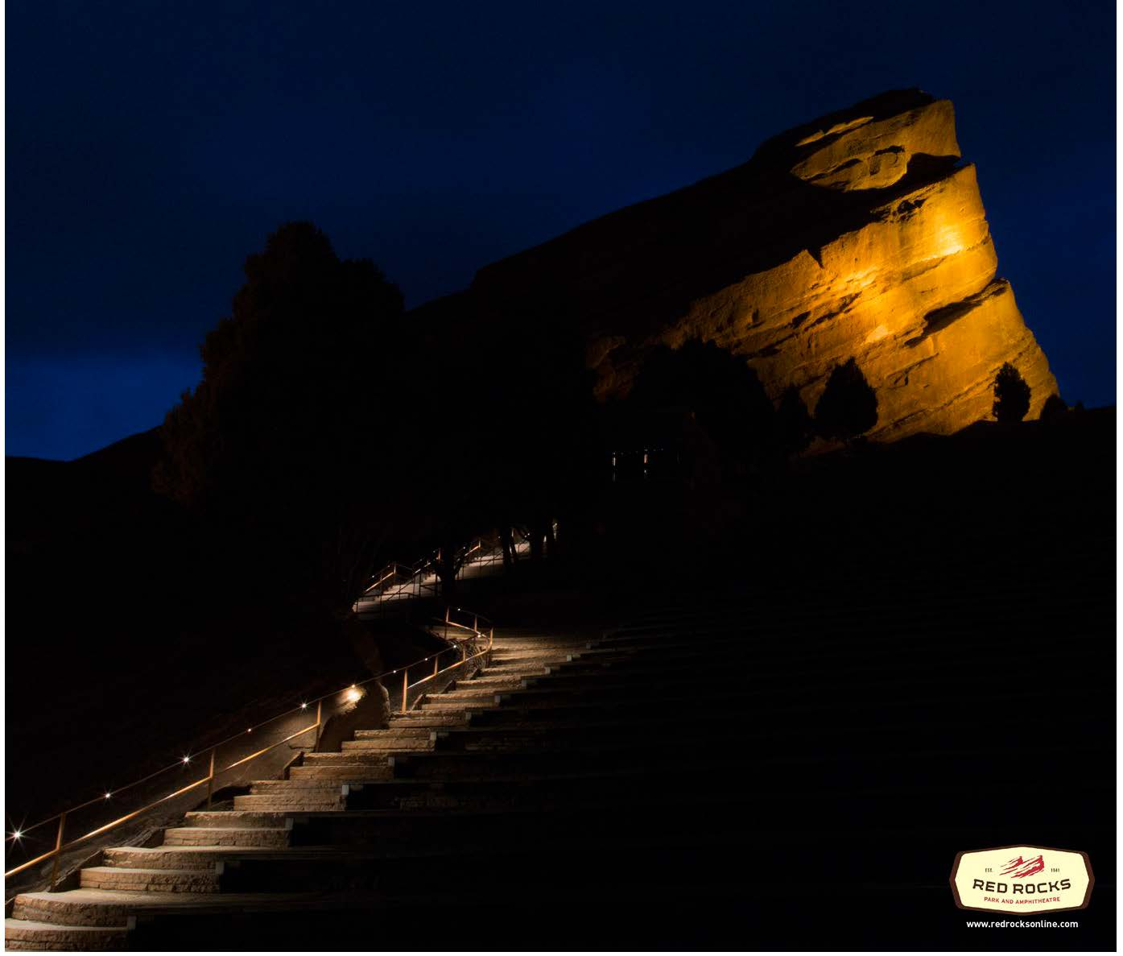

Slide 11
